Slide 1
OPIM 628
Business Analytics and Quantitative Methods
ZHENG Zhichao (Daniel)
danielzheng@smu.edu.sg
Office: 4034
Tel: 6808 5474

Slide 2
Class Outline
Feedback on Assignment (Linear Regression) and Review of Moneyball Case
Logistic Regression: Diabetes Care
Predicting quality of care for better health service delivery and monitoring

Slide 3
Problem Breakdown
Make Playoffs
Win Games
Wins = 80.8814 + 0.1058(RS – RA)
Score More Runs than Opponent
Score Runs
Don’t Allow Runs
RS = -804.63 + 2737.77(OBP) + 1584.91(SLG)
RA = -837.38 + 2913.60(OOBP) + 1514.29(OSLG)
Strong Batting
Strong Fielding and Pitching

Slide 4
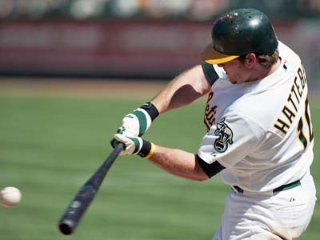
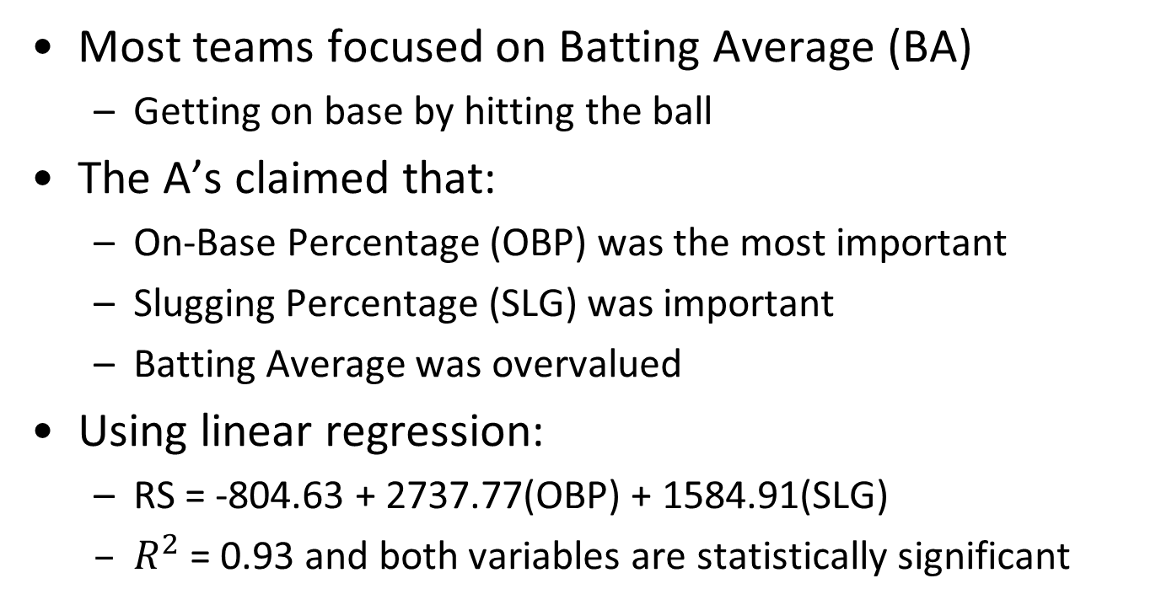
Runs Scored
Most teams focused on Batting Average (BA)
Getting on base by hitting the ball
The A’s claimed that:
On-Base Percentage (OBP) was the most important
Slugging Percentage (SLG) was important
Batting Average was overvalued
Using linear regression:
RS = -804.63 + 2737.77(OBP) + 1584.91(SLG)
$R^{2}$ = 0.93 and both variables are statistically significant
Variable selection and multicollinearity

Slide 5




Test Your Understanding
Join at www.kahoot.it or with the Kahoot! app
Enter the Game Pin
Available later when game starts
Enter your nickname: your name + last 4 digits of your campus ID, e.g., daniel1234

Slide 6
Class Outline
Feedback on Assignment (Linear Regression) and Review of Moneyball Case
Logistic Regression: Diabetes Care
Predicting quality of care for better health service delivery and monitoring

Slide 7
Service Quality vs. Efficiency
Key trade-off in many service systems
Healthcare
Improve operational efficiency without sacrificing quality
How to assess quality?
Quality of decisions vs. outcomes (risk)
Critical decisions are often made by people with expert knowledge like physicians
How to incorporate quality into operations management models?
Need quantitative and objective assessment of quality

Slide 8
Healthcare Quality Assessment
Importance: Critical in improving care quality and efficiency of healthcare operations
Timely intervention to revert poor quality care
Capacity shortage in healthcare systems
Challenge: No single set of guidelines for defining quality of healthcare
How?
Health professionals are experts in quality of care assessment

Slide 9
Experts Assessment
Healthcare quality assessment through expert opinions
Expert physicians can evaluate quality by examining a patient’s records
This process is time consuming and inefficient
Experts are limited by memory and time
They cannot assess quality for millions of patients
Similar practice in other industries
Accreditation in education, manufacturing, F&B, etc.

Slide 10
Replicating Expert Assessment
Can we develop analytical tools that replicate expert assessment?
Learn from expert human judgment
Develop a model, interpret results, and adjust the model
Make predictions/evaluations on a large scale

Slide 11

Quality of Care and Claim Data
In 2013, Professor Dimitris Bertsimas from MIT tried to predict the quality of care for diabetes patients using patients’ health insurance claims and expert’s rating on the quality of care
Identify potential candidates for case management

Slide 12
Claims Data
Electronically available
Standardized
Not 100% accurate
Claims for hospital visits can be vague
Medical Claims
Diagnosis, Procedures,
Doctor/Hospital, Cost
Pharmacy Claims
Drug, Quantity, Doctor,
Medication Cost

Slide 13
Creating the Dataset – Claims Samples
Claims Sample
Large health insurance claims database
Randomly selected 131 diabetes patients
Ages range from 35 to 55
Costs $10,000 – $20,000
September 1, 2003 – August 31, 2005

Slide 14
Creating the Dataset – Expert Review
Claims Sample
Expert physician reviewed claims and wrote descriptive notes:
Expert Review
“Ongoing use of narcotics”
“Only on Avandia, not a good
first choice drug”
“Had regular visits, mammogram,
and immunizations”
“Was given home testing supplies”

Slide 15
Creating the Dataset – Expert Assessment
Claims Sample
Rated quality on a two-point scale (poor/good)
Expert Review
“I’d say care was poor – poorly treated diabetes”
“No eye care, but overall I’d say high quality”
Expert Assessment

Slide 16
Creating the Dataset – Variable Extraction
Claims Sample
Dependent Variable
Quality of care
Independent Variables
Ongoing use of narcotics
Only on Avandia, not a good first choice drug
Had regular visits, mammogram, and immunizations
Was given home testing supplies
Expert Review
Expert Assessment
Variable Extraction

Slide 17
Creating the Dataset – Variable Extraction
Claims Sample
Dependent Variable
Quality of care
Independent Variables
Diabetes treatment
Patient demographics
Healthcare utilization
Providers
Claims
Prescriptions
Expert Review
Expert Assessment
Variable Extraction

Slide 18
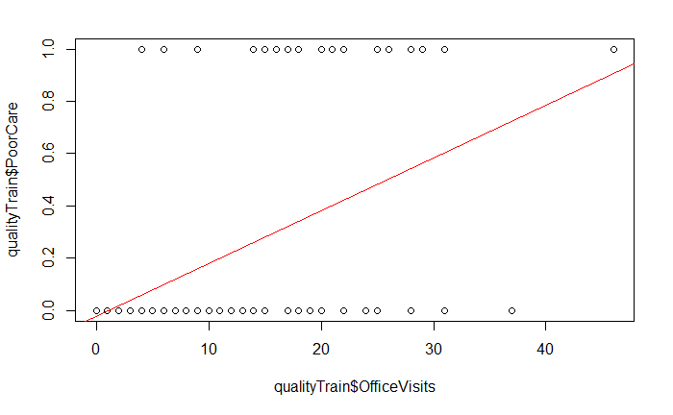
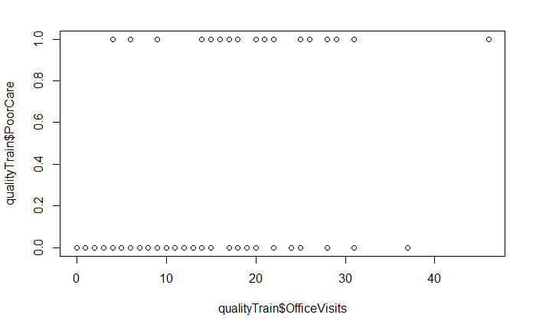
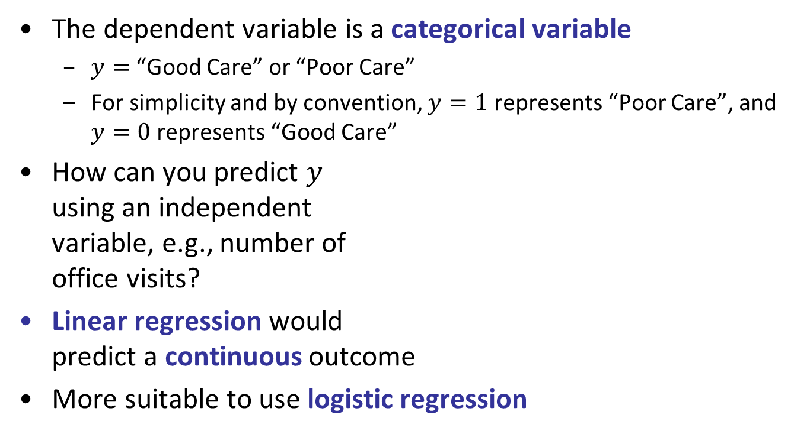
Predicting Quality of Care
The dependent variable is a categorical variable
$y=$ “Good Care” or “Poor Care”
For simplicity and by convention, $y=1$ represents “Poor Care”, and $y=0$ represents “Good Care”
How can you predict $y$ using an independent variable, e.g., number of office visits?
Linear regression would predict a continuous outcome
More suitable to use logistic regression

Slide 19
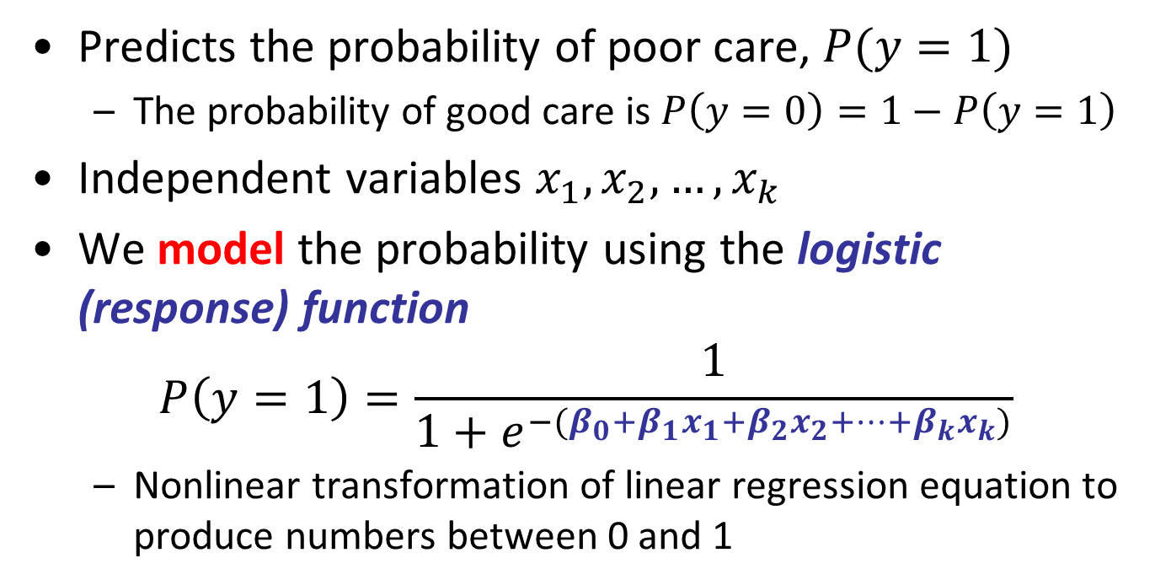
Logistic Regression
Predicts the probability of poor care, $P(y=1)$
The probability of good care is $P\left(y=0\right)=1−P\left(y=1\right)$
Independent variables $x_{1}, x_{2},…, x_{k}$
We model the probability using the logistic (response) function
$$P\left(y=1\right)=\frac{1}{1+e^{−(β_{0}+β_{1}x_{1}+β_{2}x_{2}+…+β_{k}x_{k})}}$$
Nonlinear transformation of linear regression equation to produce numbers between 0 and 1

Slide 20

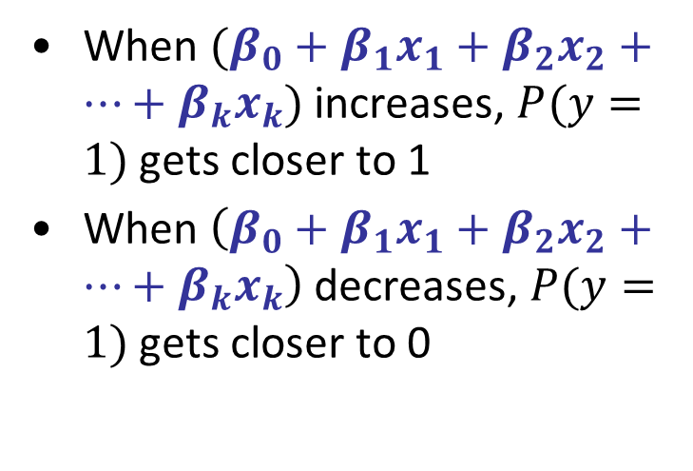

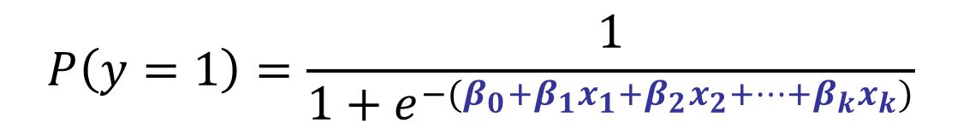
Understanding the Logistic Function
$$P\left(y=1\right)=\frac{1}{1+e^{−(β_{0}+β_{1}x_{1}+β_{2}x_{2}+…+β_{k}x_{k})}}$$
Treat the whole thing as a number
When $(β_{0}+β_{1}x_{1}+β_{2}x_{2}+…+β_{k}x_{k})$ increases, $P(y=1)$ gets closer to 1
When $\left(β_{0}+β_{1}x_{1}+β_{2}x_{2}+…+β_{k}x_{k}\right)$ decreases, $P(y=1)$ gets closer to 0
$$\frac{1}{1+e^{−x}}$$
$$x$$

Slide 21
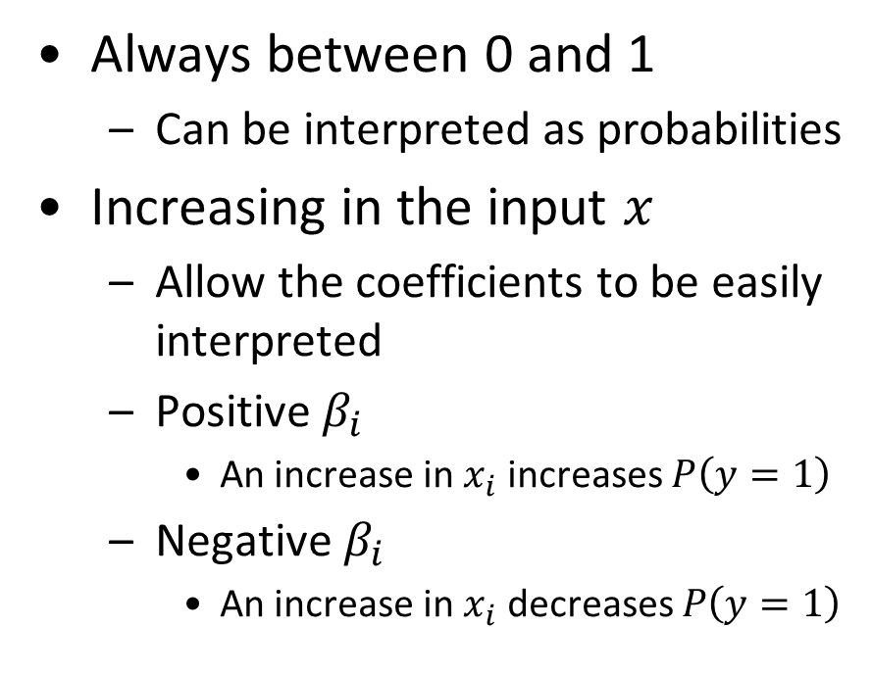
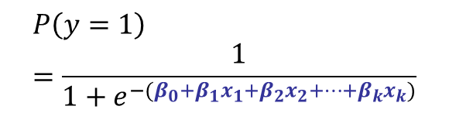
Properties of the Logistic Function
Always between 0 and 1
Can be interpreted as probabilities
Increasing in the input $x$
Allow the coefficients to be easily interpreted
Positive $β_{i}$
An increase in $x_{i}$ increases $P\left(y=1\right)$
Negative $β_{i}$
An increase in $x_{i}$ decreases $P\left(y=1\right)$
$$P\left(y=1\right)=\frac{1}{1+e^{−(β_{0}+β_{1}x_{1}+β_{2}x_{2}+…+β_{k}x_{k})}}$$
$$\frac{1}{1+e^{−x}}$$
$$x$$

Slide 22

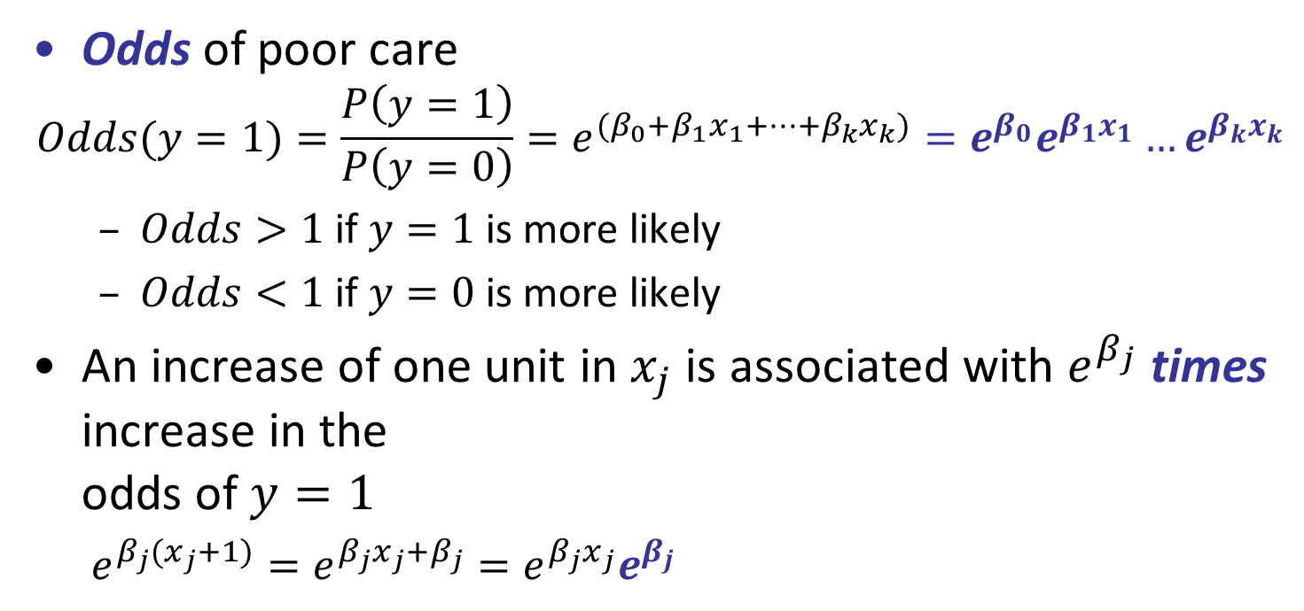
More Interpretation from Logistic Regression
Odds of poor care
$$Odds(y=1)=\frac{P\left(y=1\right)}{P\left(y=0\right)}=e^{(β_{0}+β_{1}x_{1}+…+β_{k}x_{k})}=e^{β_{0}}e^{β_{1}x_{1}}…e^{β_{k}x_{k}}$$
$Odds>1$if $y=1$is more likely
$Odds<1$if $y=0$is more likely
An increase of one unit in $x_{j}$ is associated with $e^{β_{j}}$ times increase in the odds of $y=1$
$e^{β_{j}{(x}_{j}+1)}=e^{β_{j}x_{j}+β_{j}}=e^{β_{j}x_{j}}e^{β_{j}}$
Derivation steps (not tested):
$$P(y=1) = \frac{1}{1+e^{−x}}$$
$$P(y=0) = 1 – \left(\frac{1}{1+e^{−x}}\right) = \frac{e^{−x}}{1+e^{−x}}$$
$$\frac{P\left(y=1\right)}{P\left(y=0\right)} = \frac{1}{1+e^{−x}} ∗ \frac{{1+e}^{−x}}{e^{−x}} = \frac{1}{e^{−x}} = e^{x}$$

Slide 23
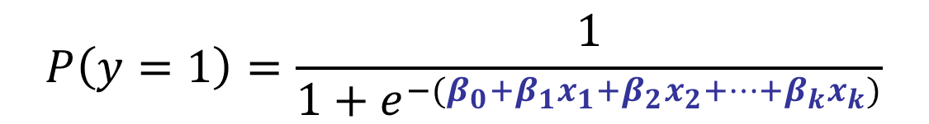
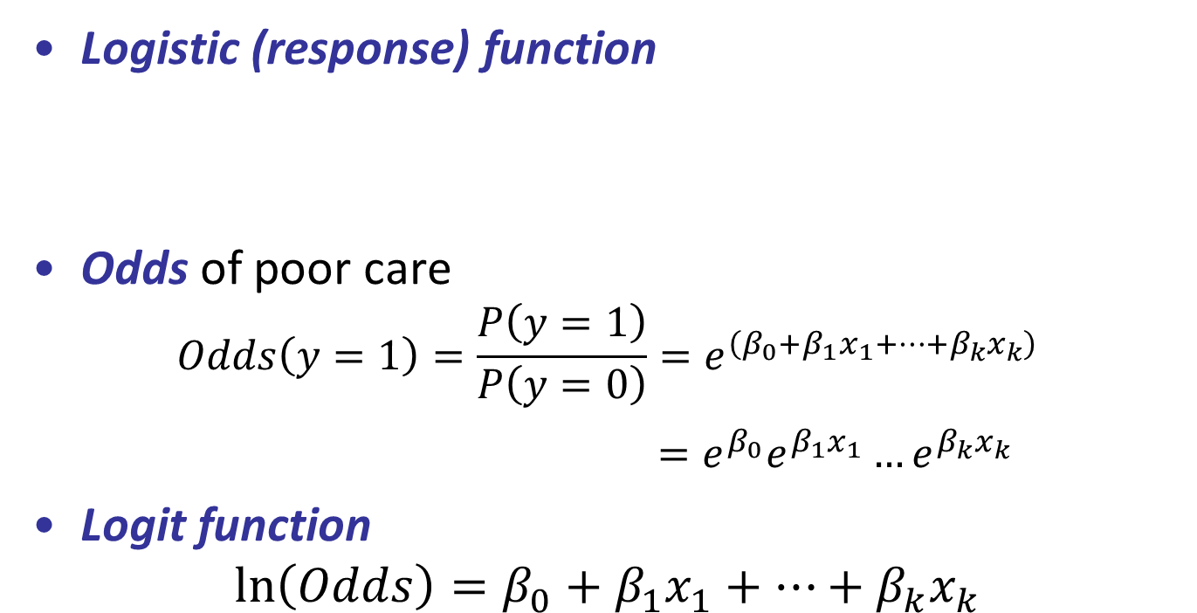
Terminology
Logistic (response) function
Odds of poor care
$$Odds\left(y=1\right)=\frac{P\left(y=1\right)}{P\left(y=0\right)}=e^{\left(β_{0}+β_{1}x_{1}+…+β_{k}x_{k}\right)}$$
$=e^{β_{0}}e^{β_{1}x_{1}}…e^{β_{k}x_{k}}$
Logit function
$$ln\left(Odds\right)=β_{0}+β_{1}x_{1}+…+β_{k}x_{k}$$
$$P\left(y=1\right)=\frac{1}{1+e^{−(β_{0}+β_{1}x_{1}+β_{2}x_{2}+…+β_{k}x_{k})}}$$

Slide 24
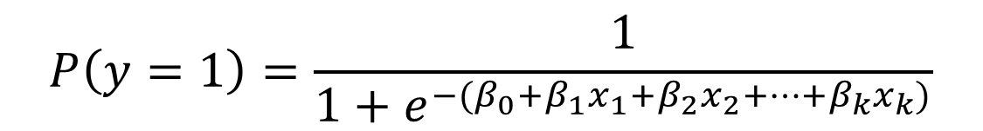
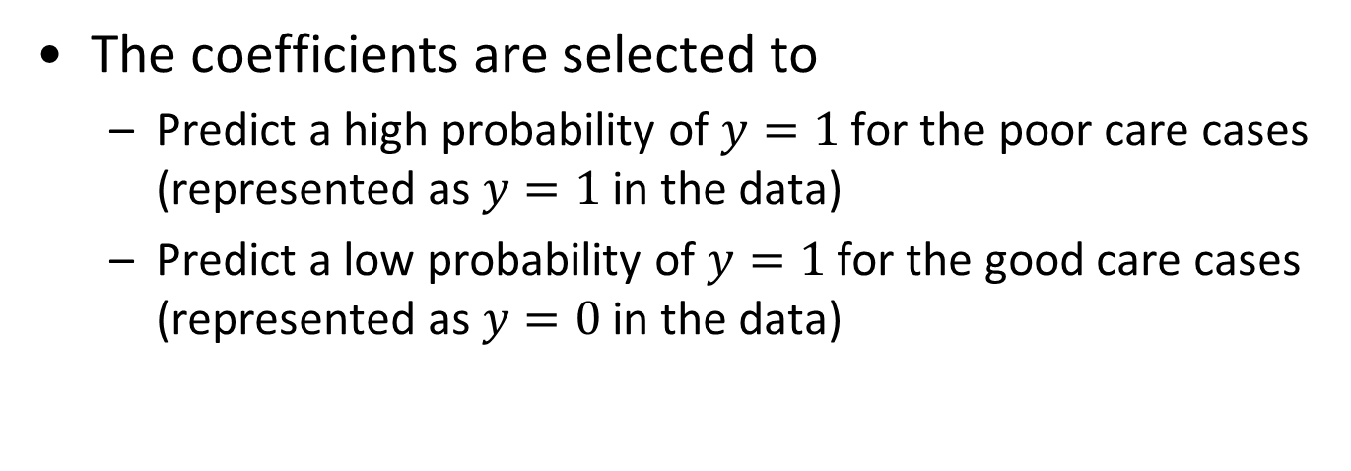
Training Logistic Regression Models
$$P\left(y=1\right)=\frac{1}{1+e^{−(β_{0}+β_{1}x_{1}+β_{2}x_{2}+…+β_{k}x_{k})}}$$
The coefficients are selected to
Predict a high probability of $y=1$for the poor care cases (represented as $y=1$in the data)
Predict a low probability of $y=1$for the good care cases (represented as $y=0$ in the data)

Slide 25
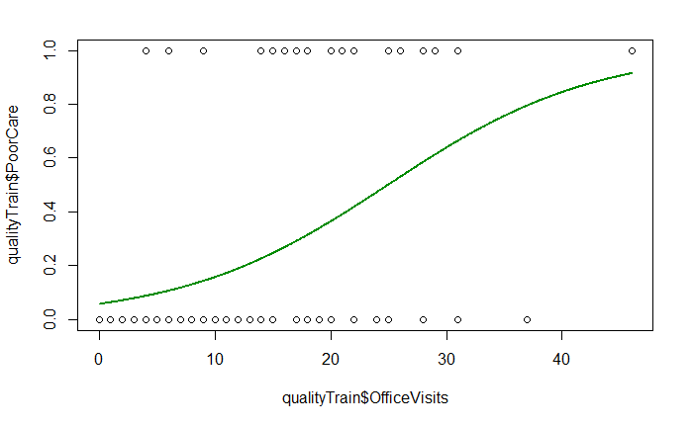
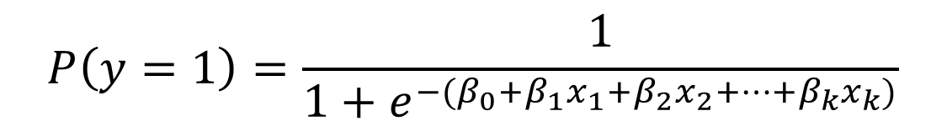
Linear vs. Logistic Regression
$$P\left(y=1\right)=\frac{1}{1+e^{−(β_{0}+β_{1}x_{1}+β_{2}x_{2}+…+β_{k}x_{k})}}$$
Note: logistic function is NOT linear in $β$’s

Slide 26
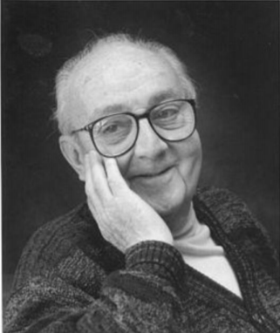
Recall: Model
“The most that can be expected from any model is that it can supply a useful approximation to reality: All models are wrong; some models are useful.”
George E. P. Box (1919-2013) One of the great statistical minds of the 20th century

Slide 27
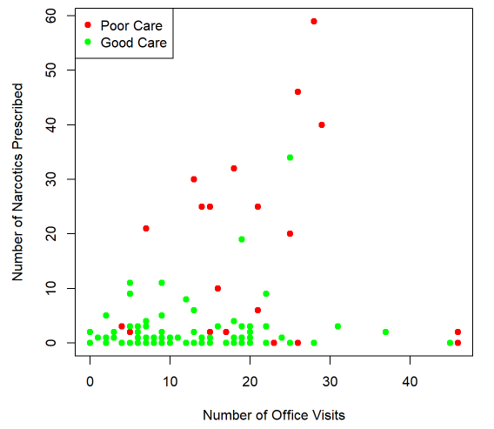
A Demonstration of Logistic Regression Model
Plot of the independent variables
Number of Office Visits (OfficeVisits)
Number of Narcotics Prescribed (Narcotics)
Red are poor care
Green are good care
Let’s build a logistic regression model using these two independent variables

Slide 28
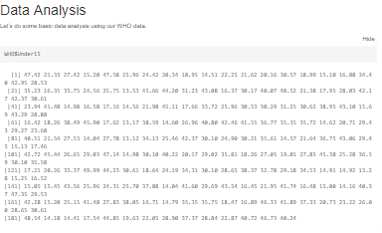

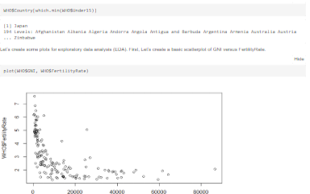
Let’s get our hands dirty!

Slide 29
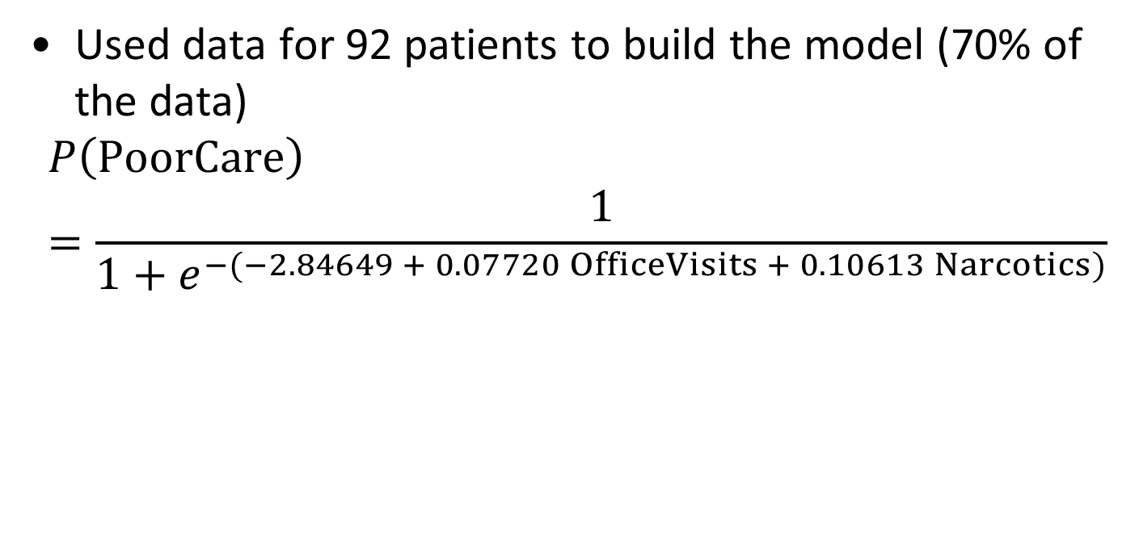
A Logistic Regression Model
Used data for 92 patients to build the model (70% of the data)
$$P\left(PoorCare\right)=\frac{1}{1+e^{−(−2.84649 + 0.07720 OfficeVisits + 0.10613 Narcotics)}}$$

Slide 30
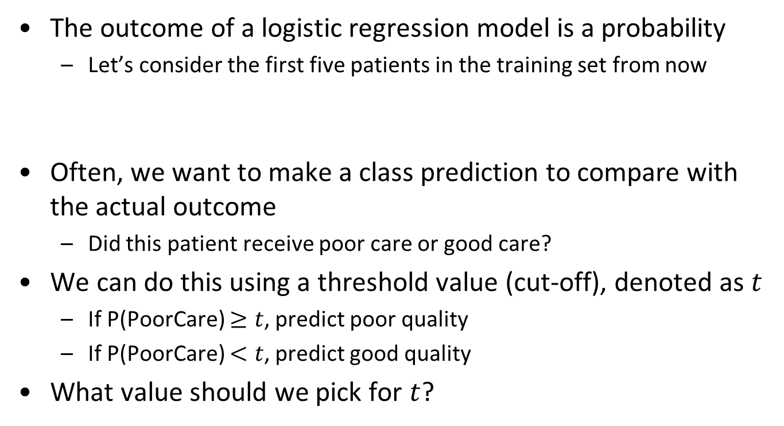
Prediction From Logistic Regression
The outcome of a logistic regression model is a probability
Let’s consider the first five patients in the training set from now
Often, we want to make a class prediction to compare with the actual outcome
Did this patient receive poor care or good care?
We can do this using a threshold value (cut-off), denoted as $t$
If P(PoorCare) $≥t$, predict poor quality
If P(PoorCare) $<t$, predict good quality
What value should we pick for $t$?
 | Patient 1 | Patient 2 | Patient 3 | Patient 4 | Patient 5
Prediction | 0.206 | 0.105 | 0.126 | 0.107 | 0.097

Slide 31
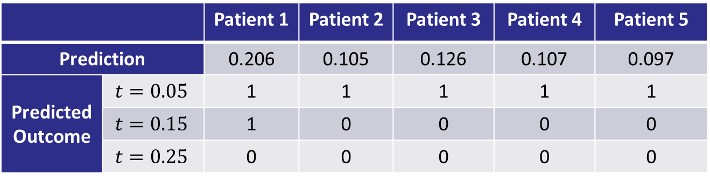

Threshold Value
If P(PoorCare) $≥t$, predict poor quality ($y=1$)
If P(PoorCare) $<t$, predict good quality ($y=0$)
If the threshold 𝑡 is small, more patients are classified as 1 (poor care)
If the threshold 𝑡 is large, more patients are classified as 0 (good care)
 |  | Patient 1 | Patient 2 | Patient 3 | Patient 4 | Patient 5
Prediction |  | 0.206 | 0.105 | 0.126 | 0.107 | 0.097
Predicted Outcome | $$t=0.05$$ | 1 | 1 | 1 | 1 | 1
 | $$t=0.15$$ | 1 | 0 | 0 | 0 | 0
 | $$t=0.25$$ | 0 | 0 | 0 | 0 | 0

Slide 32
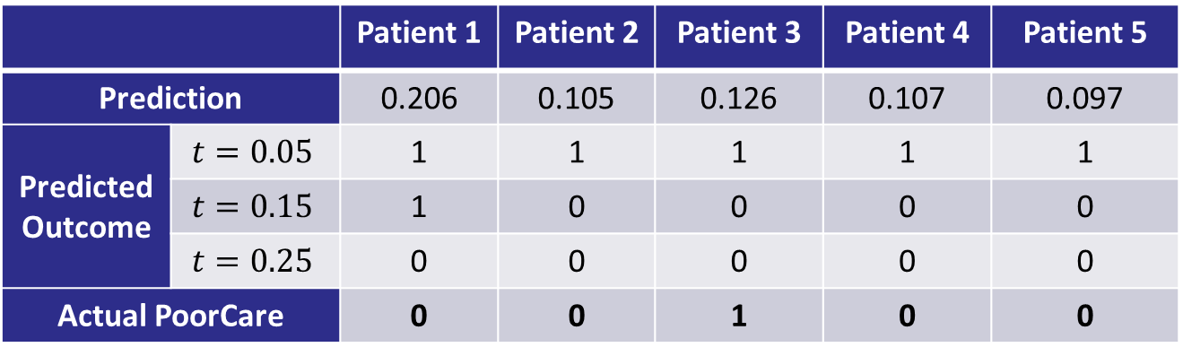
Selecting a Threshold Value
Let’s compare the predictions to the actual outcomes
 |  | Patient 1 | Patient 2 | Patient 3 | Patient 4 | Patient 5
Prediction |  | 0.206 | 0.105 | 0.126 | 0.107 | 0.097
Predicted Outcome | $$t=0.05$$ | 1 | 1 | 1 | 1 | 1
 | $$t=0.15$$ | 1 | 0 | 0 | 0 | 0
 | $$t=0.25$$ | 0 | 0 | 0 | 0 | 0
Actual PoorCare |  | 0 | 0 | 1 | 0 | 0

Slide 33
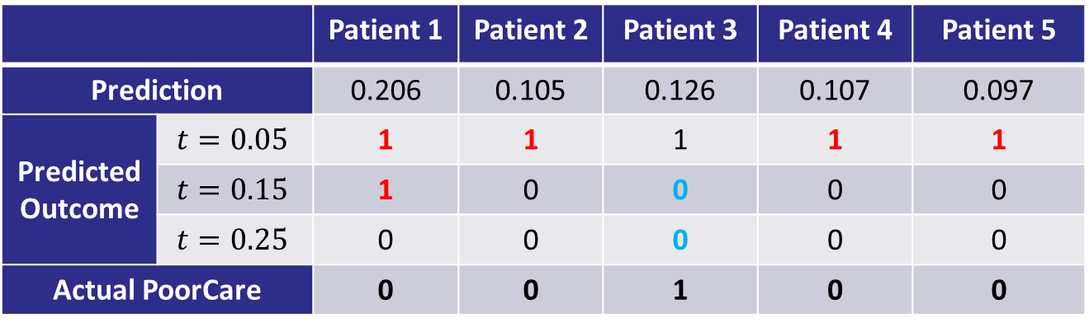
Selecting a Threshold Value
Let’s compare the predictions to the actual outcomes
Confusion matrix (classification matrix)
 |  | Patient 1 | Patient 2 | Patient 3 | Patient 4 | Patient 5
Prediction |  | 0.206 | 0.105 | 0.126 | 0.107 | 0.097
Predicted Outcome | $$t=0.05$$ | 1 | 1 | 1 | 1 | 1
 | $$t=0.15$$ | 1 | 0 | 0 | 0 | 0
 | $$t=0.25$$ | 0 | 0 | 0 | 0 | 0
Actual PoorCare |  | 0 | 0 | 1 | 0 | 0
 | Predicted Good Care (0) | Predicted Poor Care (1)
Actual Good Care (0) | True Negatives (TN) | False Positives (FP)
Actual Poor Care (1) | False Negatives (FN) | True Positives (TP)
✔
✖
✖
✔

Slide 34
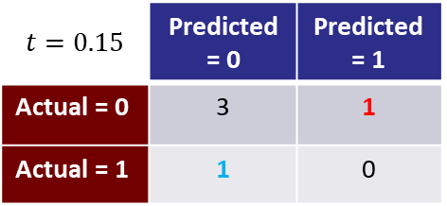
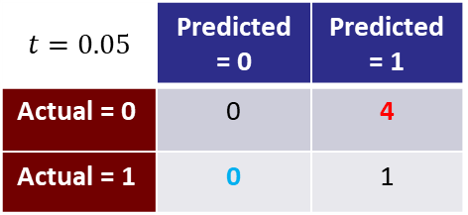

Selecting a Threshold Value
A different threshold value changes the types of errors
 |  | Patient 1 | Patient 2 | Patient 3 | Patient 4 | Patient 5
Prediction |  | 0.206 | 0.105 | 0.126 | 0.107 | 0.097
Predicted Outcome | $$t=0.05$$ | 1 | 1 | 1 | 1 | 1
 | $$t=0.15$$ | 1 | 0 | 0 | 0 | 0
 | $$t=0.25$$ | 0 | 0 | 0 | 0 | 0
Actual PoorCare |  | 0 | 0 | 1 | 0 | 0
$$t=0.05$$ | Predicted = 0 | Predicted = 1
Actual = 0 | 0 | 4
Actual = 1 | 0 | 1
$$t=0.15$$ | Predicted = 0 | Predicted = 1
Actual = 0 | 3 | 1
Actual = 1 | 1 | 0
$$t=0.25$$ | Predicted = 0 | Predicted = 1
Actual = 0 | 4 | 0
Actual = 1 | 1 | 0

Slide 35
Selecting a Threshold Value
A different threshold value changes the types of errors
If 𝑡 is small, more good-care cases are classified as poor care
More false positives
If 𝑡 is large, more poor-care cases are classified as good care
More false negatives
$$t=0.05$$ | Predicted = 0 | Predicted = 1
Actual = 0 | 0 | 4
Actual = 1 | 0 | 1
$$t=0.15$$ | Predicted = 0 | Predicted = 1
Actual = 0 | 3 | 1
Actual = 1 | 1 | 0
$$t=0.25$$ | Predicted = 0 | Predicted = 1
Actual = 0 | 4 | 0
Actual = 1 | 1 | 0

Slide 36

Selecting a Threshold Value
One way to select a threshold is based on accuracy, which measures the overall correct perdition rate
Accuracy = (TN + TP)/(# Observations)
Choose a threshold that gives high accuracy
There are implicit assumptions when you use accuracy
The threshold that gives the highest accuracy may result in a useless classification model (elaborated later)
$$t=0.05$$ | Predicted = 0 | Predicted = 1
Actual = 0 | 0 | 4
Actual = 1 | 0 | 1
$$t=0.15$$ | Predicted = 0 | Predicted = 1
Actual = 0 | 3 | 1
Actual = 1 | 1 | 0
$$t=0.25$$ | Predicted = 0 | Predicted = 1
Actual = 0 | 4 | 0
Actual = 1 | 1 | 0
0.2 | 0.6 | 0.8

Slide 37
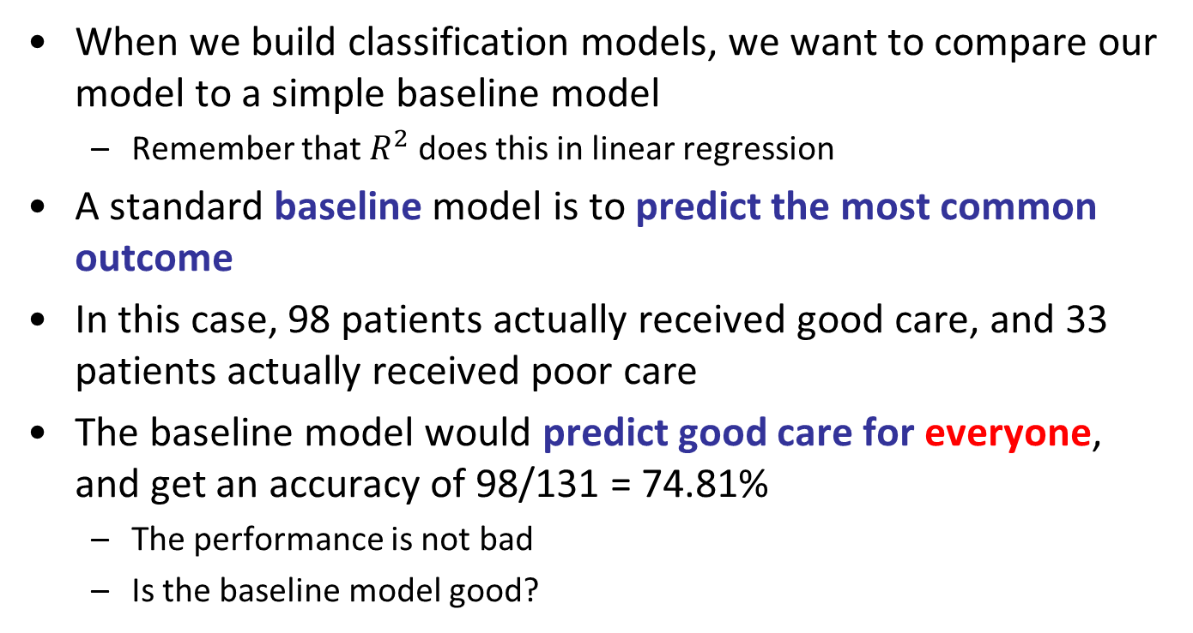
A “Baseline Model”
When we build classification models, we want to compare our model to a simple baseline model
Remember that $R^{2}$ does this in linear regression
A standard baseline model is to predict the most common outcome
In this case, 98 patients actually received good care, and 33 patients actually received poor care
The baseline model would predict good care for everyone, and get an accuracy of 98/131 = 74.81%
The performance is not bad
Is the baseline model good?

Slide 38
Issues with Accuracy
If we want to predict some rare events, e.g., “a man in the airport carrying a bomb”
Assume the proportion is 0.0001% (1 out of a million)
The baseline model will predict everyone to be innocent and has an accuracy of 99.9999%
Equivalent to set the threshold = 1 in any logistic regression model
Many sophisticated models are very likely to perform much worse than the baseline model if a threshold < 1 is used
Is the baseline model the best? Is it useful?
How to set the threshold to trigger an alarm for security check?

Slide 39
When to Use Accuracy
When is accuracy a good measure to use in threshold selection?
Cost of a false positive and cost of a false negative are similar
Accuracy = (TN + TP)/(# Observations)
= 1 – (FP + FN)/(# Observations)
Implicitly assuming the same weights (costs) on false positive and false negative
If the costs are different, we need different metrics

Slide 40
Threshold Selection and Model Selection
How should we choose a threshold?
How do we evaluate the model performance under a threshold (in a more comprehensive way than using accuracy alone)?
Before selecting a threshold, we need to select a model first (variable selection)
How can we evaluate the quality of a classification model like logistic regression?
Next class

Slide 41
Class Outline
Feedback on Assignment (Linear Regression) and Review of Moneyball Case
Logistic Regression: Diabetes Care
Predicting quality of care for better health service delivery and monitoring
End

